Slide 1


Artur Wyszomirski
10.08.2023

Slide 2

Outline
Executive Summary
Introduction
Methodology
Results
Conclusion
Appendix

Slide 3
Executive Summary
Methodology:
Data was collected via SpaceX API and web scraping Wikipedia Falcon 9 page.
Data was subset to include only the most relevant data and cleaned from flights including multiple boosters and payloads
Exploratory data analysis (EDA) using visualization and SQL
Interactive visual analytics using Folium and Plotly Dash
Predictive analysis using classification models
Results:
Mission success rate increase with time
Mission outcome can be predicted with very high accuracy

Slide 4
Introduction
SpaceX advertises Falcon 9 rocket launches on its website with a cost of 62 million dollars; other providers cost upward of 165 million dollars each, much of the savings is because SpaceX can reuse the first stage. Therefore if we can determine if the first stage will land, we can determine the cost of a launch. This information can be used if an alternate company wants to bid against SpaceX for a rocket launch.
The question we will try to answer is whether the Falcon 9 first stage will land successfully. We will also take a close look at the correlation between several factors like orbit destination, booster type, payload mass and more.

Slide 5

Section 1

Slide 6
Methodology
Executive Summary
Data collection methodology:
Data was collected via SpaceX API and web scraping Wikipedia Falcon 9 page.
Perform data wrangling
Data was subset to include only the most relevant data and cleaned from flights including multiple boosters and payloads
Perform exploratory data analysis (EDA) using visualization and SQL
Perform interactive visual analytics using Folium and Plotly Dash
Perform predictive analysis using classification models
Preprocessed data was standardized and splitted to train and test set. The train set was used to find the best model and its hyperparameters and afterwards assessed on test set. Then the model was retrained on whole set to give best predictions.

Slide 7
Data Collection
Core data is available at https://api.spacexdata.com/v4/launches/past
The dataset was enriched with additional data from following URIs:
https://api.spacexdata.com/v4/rockets/
https://api.spacexdata.com/v4/launchpads/
https://api.spacexdata.com/v4/payloads/
https://api.spacexdata.com/v4/cores/
Wikipedia page URL: https://en.wikipedia.org/w/index.php?title=List_of_Falcon_9_and_Falcon_Heavy_launches&oldid=1027686922

Slide 8
Data Collection – SpaceX API
Request core data from API
Enrich dataset with detailed data
Filter data for Falcon 9 launches
Clean dataset
Export data to CSV file
1
2
3
4
5
https://github.com/ArturWyszomirski/Coursera/blob/main/Capstone/Week_1/jupyter-labs-spacex-data-collection-api_solved.ipynb

Slide 9
Data Collection - Scraping
Request the Falcon 9 Launch Wiki
Extract data from HTML table
Clean dataset
Put data to a DataFrame
Export data to CSV file
1
2
3
4
5
https://github.com/ArturWyszomirski/Coursera/blob/main/Capstone/Week_1/jupyter-labs-webscraping_partialy_solved.ipynb

Slide 10
Data Wrangling
Import data from CSV file
Identify missing values
Define launch outcomes
Add column with launch outcome
Export data to CSV file
1
2
3
4
5
https://github.com/ArturWyszomirski/Coursera/blob/main/Capstone/Week_1/labs-jupyter-spacex-Data%20wrangling_solved.ipynb

Slide 11
EDA with Data Visualization
Payload mass vs flight number with mission outcome hue scatter plot
Launch site vs flight number with mission outcome hue scatter plot
Payload mass vs flight number with mission outcome hue scatter plot
Orbit vs mission outcome scatter plot
Mission outcome mean grouped by orbit bar plot
Orbit vs flight number with mission outcome hue scatter plot
Orbit vs payload mass with mission outcome hue scatter plot
Mission outcome mean by year line chart
https://github.com/ArturWyszomirski/Coursera/blob/main/Capstone/Week_2/jupyter-labs-eda-dataviz_solved.ipynb

Slide 12
EDA with SQL
Names of the unique launch sites in the space mission
5 records where launch sites begin with the string 'CCA'
Total payload mass carried by boosters launched by NASA (CRS)
Average payload mass carried by booster version F9 v1.1
Date when first successful landing outcome in ground pad was achieved
Names of the boosters which have success in drone ship and have payload mass greater than 4000 but less than 6000
Total number of successful and failure mission outcomes
Names of the booster versions which have carried the maximum payload mass
Records which will display the month names, failure landing outcomes in drone ship, booster versions, launch site for the months in year 2015
Count of landing outcomes (such as Failure (drone ship) or Success (ground pad)) between the date 2010-06-04 and 2017-03-20
https://github.com/ArturWyszomirski/Coursera/blob/main/Capstone/Week_2/jupyter-labs-eda-sql-coursera_sqllite_solved.ipynb

Slide 13
Build an Interactive Map with Folium
All launch sites on a map
Success/failed launches for each site on the map
Distances between a launch site to its proximities
https://github.com/ArturWyszomirski/Coursera/blob/main/Capstone/Week_3/lab_jupyter_launch_site_location_solved.ipynb

Slide 14
Build a Dashboard with Plotly Dash
Dropdown to select launch site.
Dashboard representing distribution of launch sites and success/failure rate from each site. Data is shown on a pie chart.
Slider to select payload mass range
Dashboard representing correlation between payload mass and mission outcome with booster version hue.
https://github.com/ArturWyszomirski/Coursera/blob/main/Capstone/Week_3/spacex_dash_app.py

Slide 15
Predictive Analysis (Classification)
Load data from CSV file.
Format features and labels to a NumPy array
Standardize data
Use GridSearchCV to find best hyperparameters for different classification models
Assessment of models
Pick model with the best performance
https://github.com/ArturWyszomirski/Coursera/blob/main/Capstone/Week_4/SpaceX_Machine_Learning_Prediction_Part_5.jupyterlite_solved.ipynb

Slide 16
Results
Mission success rate is increasing with time
Mission with higher payload has higher success rate
The most frequently used site launch was CCAFS SLC 40
Site launch with highest mission success rate was KSC LC 39A
ES-L1, GEO, HEO, SSO orbits has the highest mission success rate
Most of recent flights were targeted to VLEO and ISS orbit
Highest payloads were targeted to VLEO orbit
Only one mission with payload higher than 10 000 kg was failed
Mission outcomes can be predicted with about 94% accuracy

Slide 17

Section 2

Slide 18
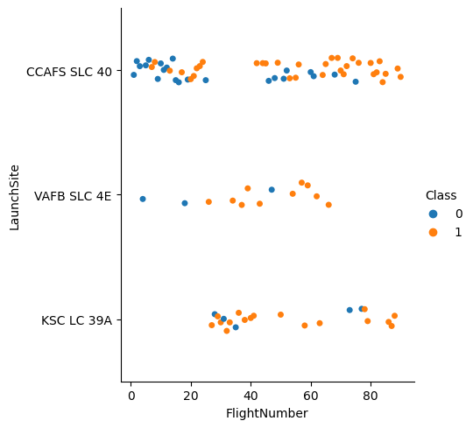
Flight Number vs. Launch Site
Orange dots represents successful missions
Blue dots represents failed missions
The most frequently used site was CCAFS SLC 40

Slide 19
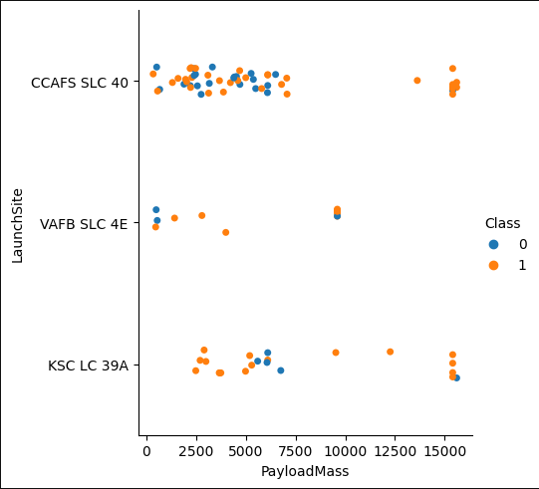
Payload vs. Launch Site
Orange dots represents successful missions
Blue dots represents failed missions
The biggest payloads were launched from CCAFS SLC 40 and KSC LC 39A
There were no missions with payload above 10 000 kg from VAFB SLC 4E

Slide 20
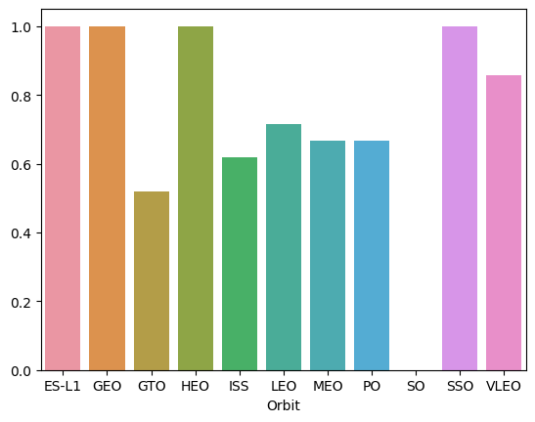
Success Rate vs. Orbit Type
Each bar represents mission success rate for a particular orbit
ES-L1, GEO, HEO, SSO orbits has the highest mission success rate
SO has the lowest mission success rate

Slide 21
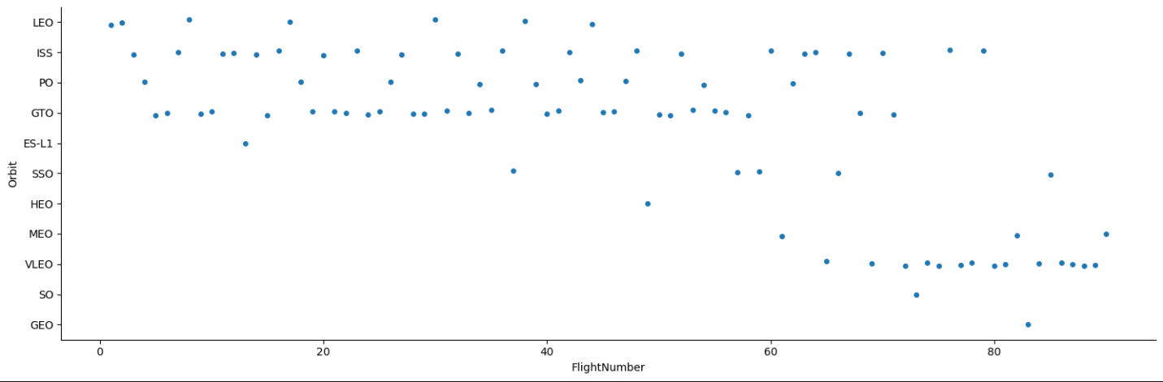
Flight Number vs. Orbit Type
The most of recent flights were taken to VLEO and ISS orbits
Mission to ISS orbit are performed regularly
The most frequently targeted orbits are GTO and ISS
Number of missions to VLEO orbit increased in recent time

Slide 22
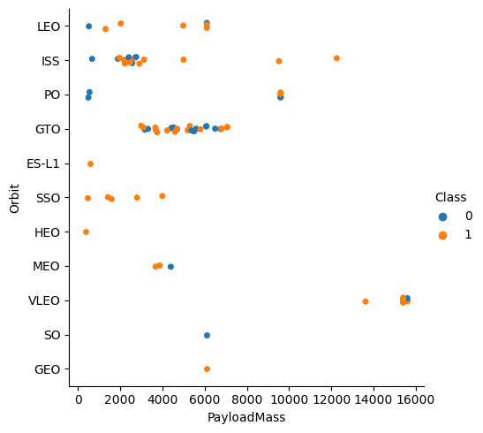
Payload vs. Orbit Type
Most of high payload mass mission was carried out to VLEO orbit
Only 3 orbits (VLEO, PO, ISS) was targeted with payload higher than 8 000 kg
Orbits with the lowest payloads are ES-L1 and HEO

Slide 23
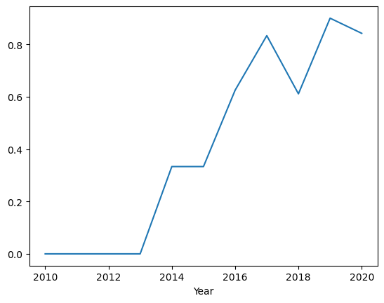
Launch Success Yearly Trend
Mission success rate increase in time
Mission success rate seems to be stabilising at 0.8
There were no successful mission until 2013

Slide 24
All Launch Site Names
CCAFS LC-40
VAFB SLC-4E
KSC LC-39A
CCAFS SLC-40

Slide 25
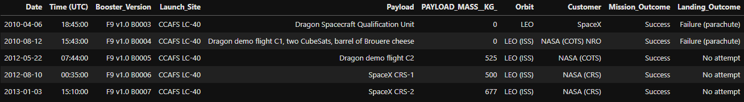
Launch Site Names Begin with 'CCA'
List of 5 record with launch sites beginning with ‘CCA’:

Slide 26
Total Payload Mass
Total payload carried by boosters from NASA is 619967 kg

Slide 27
Average Payload Mass by F9 v1.1
Average payload mass carried by booster version F9 v1.1 is 2534.67 kg

Slide 28
First Successful Ground Landing Date
Date of the first successful landing outcome on ground pad is 2015-12-22

Slide 29
Successful Drone Ship Landing with Payload between 4000 and 6000
Names of boosters which have successfully landed on drone ship and had payload mass greater than 4000 but less than 6000:
F9 FT B1022
F9 FT B1026
F9 FT B1021.2
F9 FT B1031.2

Slide 30
Total Number of Successful and Failure Mission Outcomes
Total number of successful and failure mission outcomes:
Mission_Outcome count(Mission_Outcome)
Failure (in flight) 1
Success 98
Success 1
Success (payload status unclear) 1

Slide 31
Boosters Carried Maximum Payload
List the names of the booster which have carried the maximum payload mass:
F9 B5 B1048.4
F9 B5 B1049.4
F9 B5 B1051.3
F9 B5 B1056.4
F9 B5 B1048.5
F9 B5 B1051.4
F9 B5 B1049.5
F9 B5 B1060.2
F9 B5 B1058.3
F9 B5 B1051.6
F9 B5 B1060.3
F9 B5 B1049.7

Slide 32
2015 Launch Records
Failed landing_outcomes in drone ship, their booster versions, and launch site names for in year 2015:
Month Landing_Outcome Booster_Version Launch_Site
04 Failure (drone ship) F9 v1.1 B1015 CCAFS LC-40
10 Failure (drone ship) F9 v1.1 B1012 CCAFS LC-40

Slide 33
Rank Landing Outcomes Between 2010-06-04 and 2017-03-20
Rank the count of landing outcomes (such as Failure (drone ship) or Success (ground pad)) between the date 2010-06-04 and 2017-03-20, in descending order
Landing_Outcome count(Landing_Outcome)
Controlled (ocean) 3
Failure (drone ship) 5
Failure (parachute) 1
No attempt 10
Precluded (drone ship) 1
Success (drone ship) 5
Success (ground pad) 5
Uncontrolled (ocean) 2

Slide 34

Section 3

Slide 35
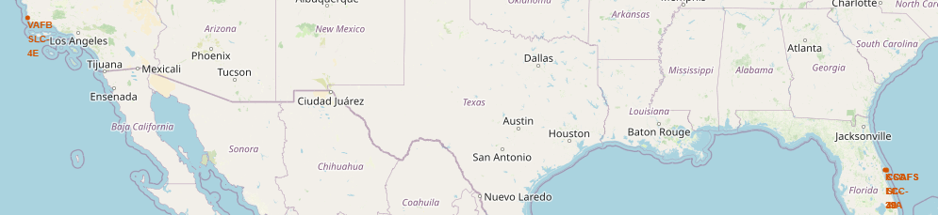
Launch sites map
Launch sites are located at Vandenberg Space Force Base in California and Cape Canaveral in Florida
Sites are located near coastlines, away from densely populated areas and in the southern region of USA because it’s more efficient to launch rockets as near equator as possible

Slide 36
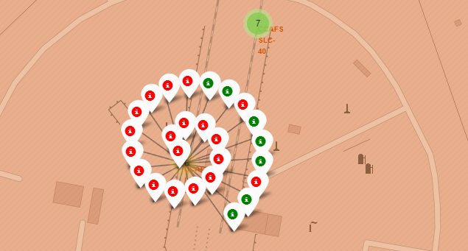
Mission outcome
Red markers indicates failed launches while green successful for each site
Value inside cluster indicates number of launch attempts from particular site

Slide 37
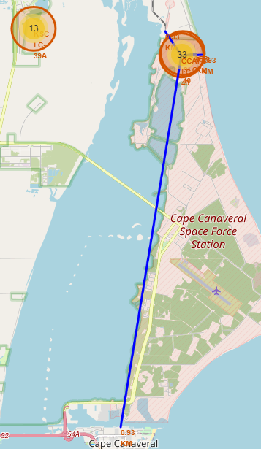
Launch site proximities
Map represents distance to nearest coastline, railway, highway and city from CCAFS LC-40 launch site
Blue line represents the distance between launch site and proximity
Marker at the end of blue line gives information about the distance in km

Slide 38

Section 4

Slide 39
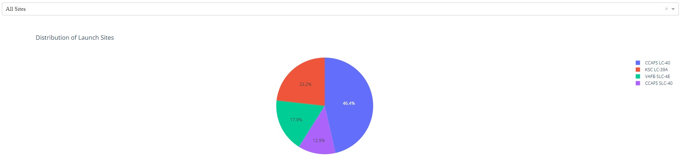
Launch success count for all sites
Most launches were taken from CCAFS LC-40

Slide 40
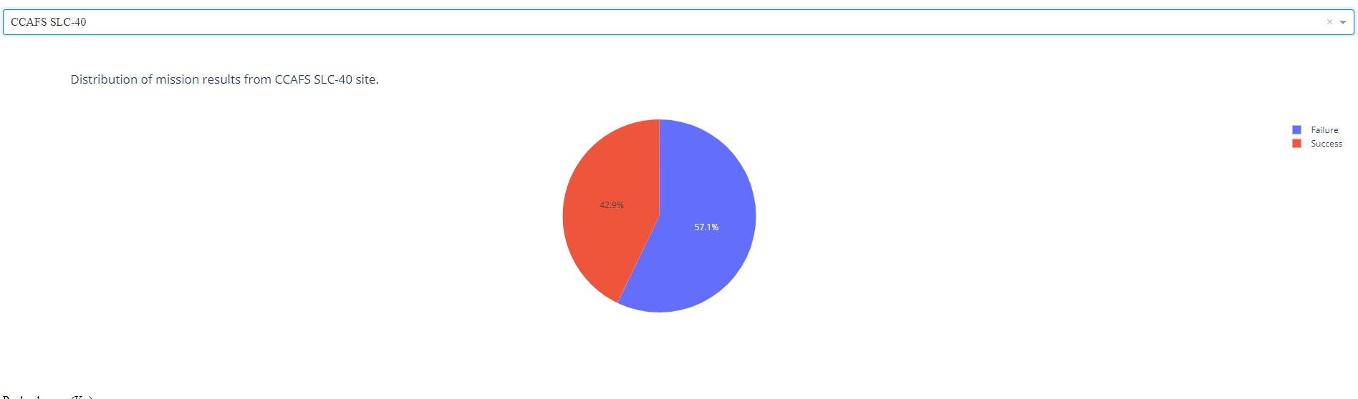
Launch site with highest launch success ratio
Site with the highest launch success ratio is CCAFS SLC-40.

Slide 41
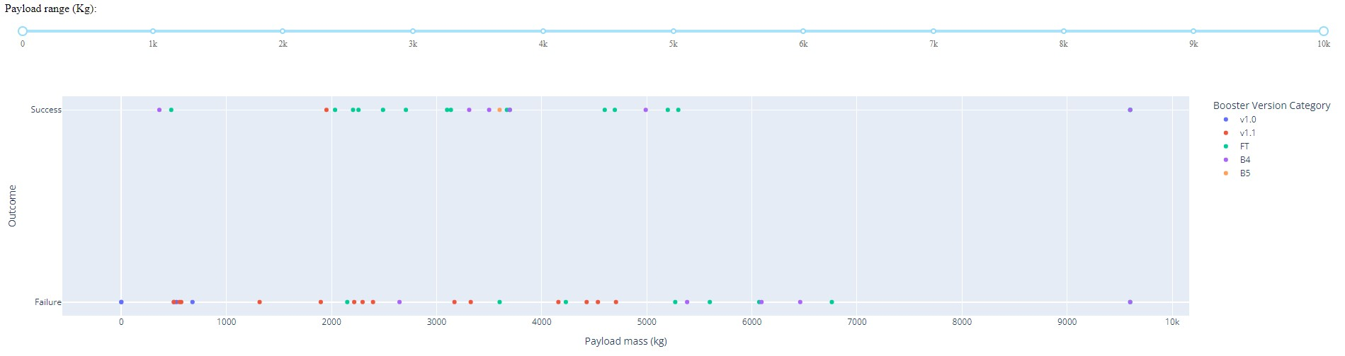
Payload vs. Launch Outcome scatter plot for all sites
Highest ratio of successful mission is for payload between 3 000 and 4 000 kg.

Slide 42

Section 5

Slide 43
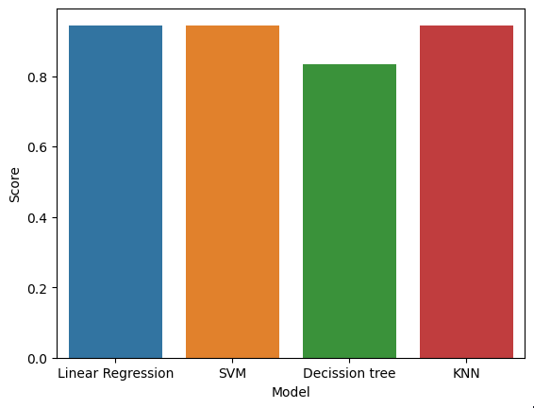
Classification Accuracy
Linear regression, SVM and KNN has the same score equal to 0.94

Slide 44

Confusion Matrix
Confusion matrix shows that only one prediction out of eighteen was wrong where the prediction was that rocket will land but in fact it didn’t.

Slide 45
Conclusions
Mission success rate is increasing with time
Mission with higher payload has higher success rate
The most frequently used site launch was CCAFS SLC 40
Site launch with highest mission success rate was KSC LC 39A
ES-L1, GEO, HEO, SSO orbits has the highest mission success rate
Most of recent flights were targeted to VLEO and ISS orbit
Highest payloads were targeted to VLEO orbit
Only one mission with payload higher than 10 000 kg was failed
Mission outcomes can be predicted with about 94% accuracy by several classification algorithms such as Linear Regression, SVM and KNN

Slide 46
Appendix
All notebooks and CSV are available at: https://github.com/ArturWyszomirski/Coursera/tree/main/Capstone
Maps are available at: https://github.com/ArturWyszomirski/Coursera/blob/main/Capstone/Week_3/lab_jupyter_launch_site_location_solved.ipynb
Dashboards are available at: https://github.com/ArturWyszomirski/Coursera/blob/main/Capstone/Week_3/spacex_dash_app.py
Machine learning including best models and their hyperparameters are available at: https://github.com/ArturWyszomirski/Coursera/blob/main/Capstone/Week_4/SpaceX_Machine_Learning_Prediction_Part_5.jupyterlite_solved.ipynb

Slide 47


